Slide 1
Network Review
Bits and Bytes

Slide 2
Understanding TCP and Connection Protocols
Brief overview of today's topics: TCP 3-way handshake, connection-oriented protocols, and connectionless oriented protocols.

Slide 3
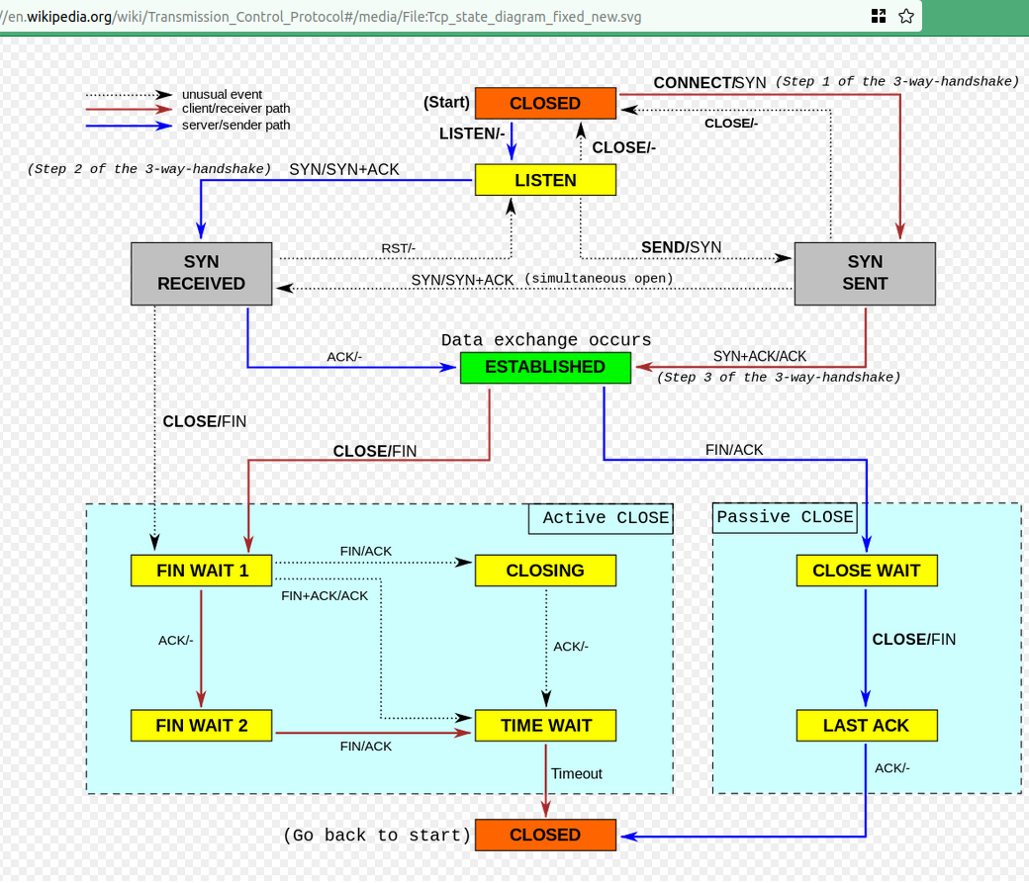

Slide 4
TCP 3-way Handshake
Step 1: Client sends a SYN (synchronize) packet to the server.
Step 2: Server responds with a SYN-ACK (synchronize-acknowledge) packet.
Step 3: Client sends an ACK (acknowledge) packet back to the server.

Slide 5
Why 3-way Handshake?
Ensures both the client and server are ready for data transfer.
Validates that both parties can send and receive packets.
Establishes parameters for the connection.

Slide 6
Connection-Oriented Protocols
Definition: Protocols that establish a connection before transferring data.
Examples: TCP, FTP, HTTP.
Characteristics:
Reliable data transfer.
Error-checking and correction.
Ordered data transfer.

Slide 7
Connectionless-Oriented Protocols
Definition: Protocols that don't establish a connection before transferring data.
Examples: UDP, ICMP.
Characteristics:
May not guarantee data delivery.
No error-checking or correction.
Faster data transfer due to fewer overheads.

Slide 8
Comparing the Two
Table comparing the two:
Connection: Required for connection-oriented, not required for connectionless.
Reliability: High for connection-oriented, variable for connectionless.
Use Cases: Streaming, file transfer for connection-oriented; VoIP, online gaming for connectionless.

Slide 9
Real-world Applications
How websites use both TCP (HTTP/HTTPS) and UDP (DNS).
Why video calls might use UDP.
Why file transfers typically use TCP.

Slide 10
Stateful vs. Stateless: Networking Perspective
Brief introduction to the concepts of stateful and stateless in the context of networking.
Highlight: The foundation for understanding firewalls and iptables.

Slide 11
Connection-Oriented Protocols: TCP
TCP establishes a connection using the 3-way handshake.
Maintains state information about the connection.
Ensures reliable and ordered data transfer.

Slide 12
Connectionless Protocols: UDP
UDP sends data without establishing a connection.
Does not maintain state information.
Faster data transfer but may not guarantee delivery.

Slide 13
Stateful Networking: Remembering Connections
Systems remember past interactions and sessions.
Useful for ensuring data integrity and security.
Example: Stateful firewalls track the state of active connections.

Slide 14
Stateless Networking
Each request or packet is treated as an isolated transaction.
Efficient for handling large-scale operations.
Example: Stateless firewalls treat each packet individually.

Slide 15
Stateful Firewalls
Track the state of active connections.
Can determine if an incoming packet is part of an established connection.
Enhanced security by understanding the context of network traffic.

Slide 16
Stateless Firewalls: Treating Packets Individually
Use predefined rules to allow or block packets.
Do not track the state of connections.
Faster but may not provide the same level of security.

Slide 17
Why Does It Matter for iptables?
iptables can be configured to act as both stateful and stateless firewalls.
Understanding state helps in configuring and managing iptables rules effectively.
Provides a foundation for advanced firewall configurations.

Slide 18
Ports and Protocols: The Basics
Brief introduction to what ports and protocols are.
Highlight: Ports are endpoints for communication, while protocols define the rules for communication.

Slide 19
TCP vs. UDP: Two Distinct Protocols
TCP: Connection-oriented, reliable, establishes a connection using a 3-way handshake.
UDP: Connectionless, faster, does not establish a formal connection.

Slide 20
Port Numbers: The Basics
Ports are 16-bit numbers, ranging from 0 to 65535.
Used to identify specific processes or services on a computer.
Common services have well-known port numbers (e.g., HTTP on port 80).

Slide 21
Sharing Port Numbers: Is It Possible?
Yes, TCP and UDP can use the same port number on the same machine without conflict.
They are distinct protocols and are treated separately by the operating system.

Slide 22
Practical Example: Port 53
DNS typically uses port 53.
DNS can operate over both TCP and UDP, depending on the situation.
A machine can have port 53 open for both TCP and UDP simultaneously without any issues.

Slide 23
Why Can TCP and UDP Share Port Numbers?
The combination of IP address, port number, and protocol (TCP/UDP) creates a unique endpoint for communication.
This combination ensures there's no ambiguity when a computer receives network traffic.

Slide 24
Practical Implications of Shared Port Numbers
Allows flexibility in designing network applications.
Some applications might use both TCP and UDP for different purposes but want to use the same port number for simplicity.

Slide 25
Introduction to Network Ports
Brief introduction to what network ports are.
Highlight: Ports are endpoints for communication in the networking world.

Slide 26
Well-Known Ports: Defined Standards
Range: 0-1023
Reserved for standard services (e.g., HTTP on port 80, HTTPS on port 443).
Defined by the Internet Assigned Numbers Authority (IANA).

Slide 27
Ephemeral Ports: Dynamic & Temporary
Range: Varies by OS, typically 1024-49151.
Used for outbound connections or as temporary ports for inbound responses.
Allocated dynamically and released when no longer needed.

Slide 28
Why Do We Need Ephemeral Ports?
Allow multiple simultaneous connections from one IP address.
Provide dynamic ports for client-side of the connection.
Essential for client-server communication where numerous clients connect to a server.

Slide 29
Source vs. Destination Ports
Source Port: Ephemeral port used by the client for outbound connections.
Destination Port: Port on the server where a service is listening (often a well-known port).

Slide 30
Practical Example
User's computer (source) might use ephemeral port 49562 to request a webpage.
Web server (destination) uses well-known port 80 to listen for incoming HTTP requests.

Slide 31
Importance in Stateful Firewalling
Stateful firewalls track the state of active connections.
They use source and destination ports to determine if incoming traffic is a legitimate response.
E.g., If a request was made from source port 49562 to destination port 80, the firewall expects a response to come back to port 49562.

Slide 32
Recap: Understanding Ports in Networking
Well-known ports are standard and reserved.
Ephemeral ports are dynamic and used for outbound connections.
Source and destination ports are crucial for understanding network communication and are vital for stateful firewalling.

